Slide 1
Lecture 3: Backpropagation and Neural Networks
Dmitry Yashunin IntelliVision

Slide 2
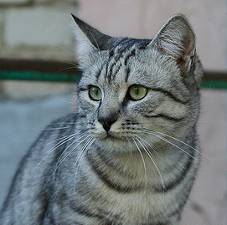
Recall from last time: Linear Classifier
Image
3072x1
s – scores
W – weights or parameters
x – image pixels
b – bias
s=f(x,W) = Wx + b
10x1
10x1
10x3072
Array of 32x32x3 numbers
(3072 numbers total)
CIFAR-10
50,000 training images
10,000 testing images
10 classes

Slide 3
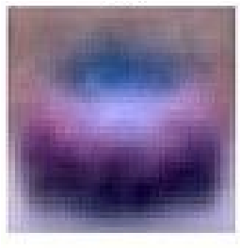
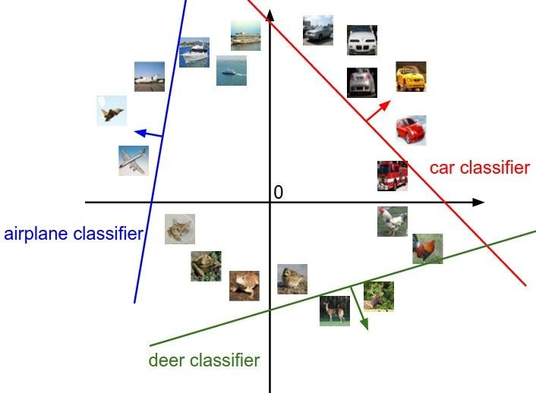
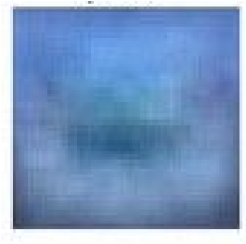
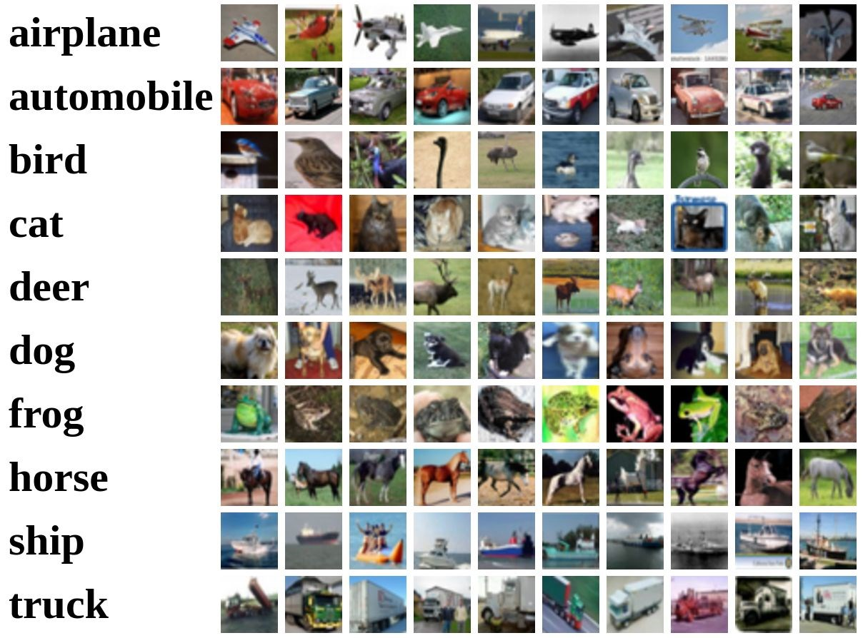
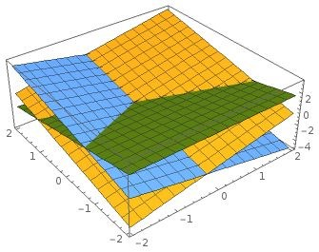
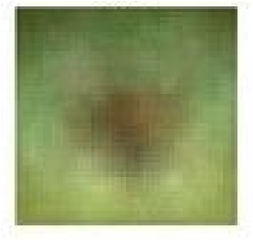
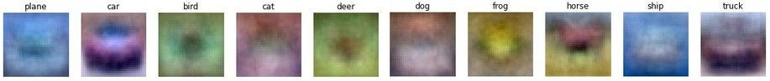
Recall from last time: Linear classifier interpretation
CIFAR-10
f(x,W) = Wx + b
Example trained weights of a linear classifier trained on CIFAR-10:

Slide 4
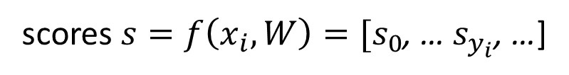
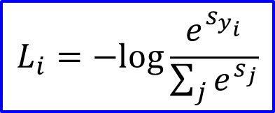
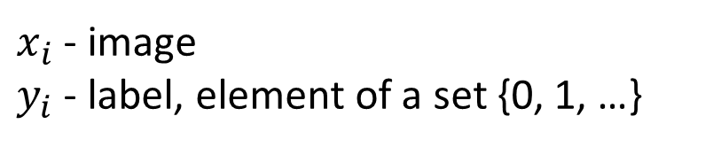
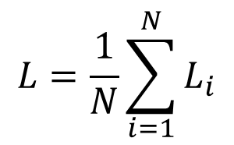
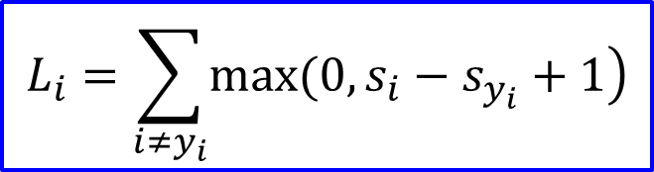
Recall from last time: Loss functions
Image
$x_{i}$ - image
$y_{i}$ - label, element of a set {0, 1, …}
scores $s=f\left(x_{i},W\right)=[s_{0}$, … $s_{y_{i}}$, …]
Loss over dataset:
Multiclass SVM (hinge) loss:
Cross-entropy (softmax) loss:
$$L=\frac{1}{N}\sum_{i=1}^{N}{L_{i}}$$
$$L_{i}=\sum_{i≠y_{i}}{\left.max(0,s_{i}−s_{y_{i}}+1\right)}$$
$$L_{i}=−log\frac{e^{s_{y_{i}}}}{\sum_{j}{e^{s_{j}}}}$$

Slide 5
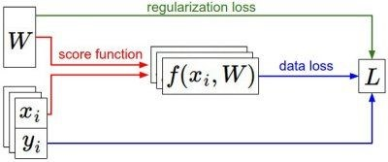
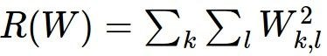
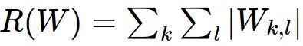
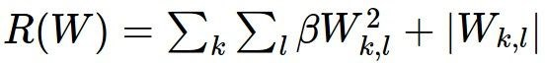
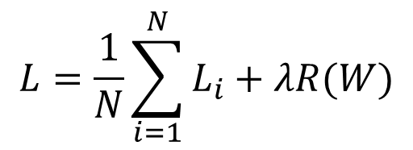
Recall from last time: Regularization
Softmax or
SVM
λ - regularization strength (hyperparameter)
$$L=\frac{1}{N}\sum_{i=1}^{N}{L_{i}}+λR(W)$$
Full loss
How do we find the best W?
Data loss
Regularization
L2 regularization
L1 regularization
Elastic net (L1 + L2)

Slide 6
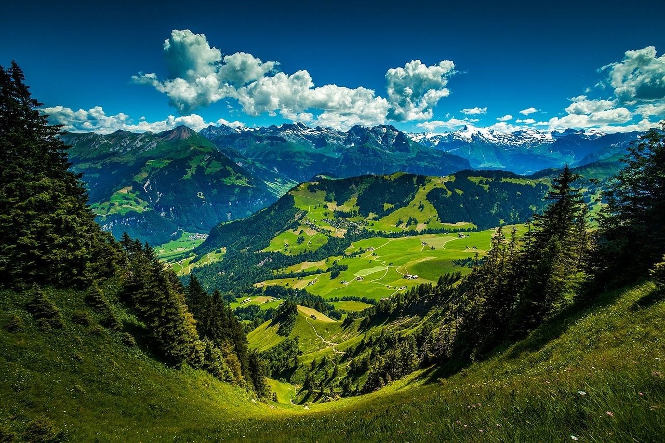
Optimization

Slide 7

Optimization

Slide 8
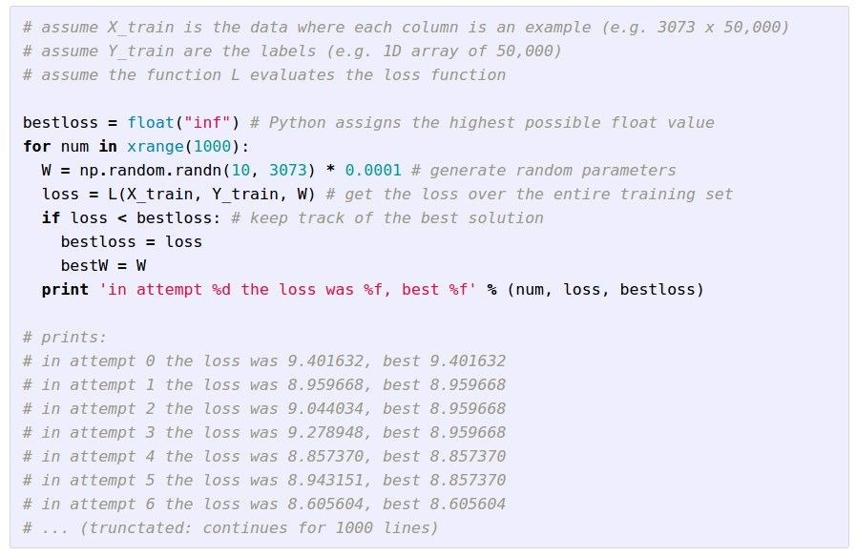
Strategy #1: A first very bad idea solution: Random search

Slide 9
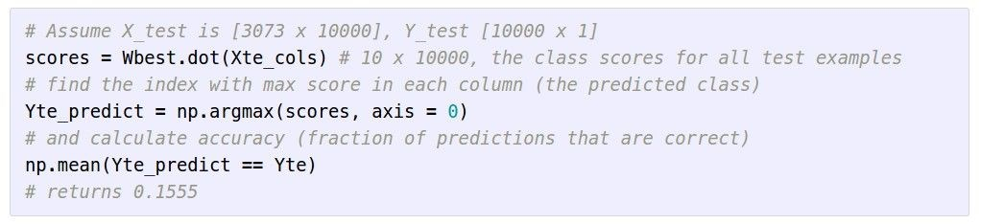
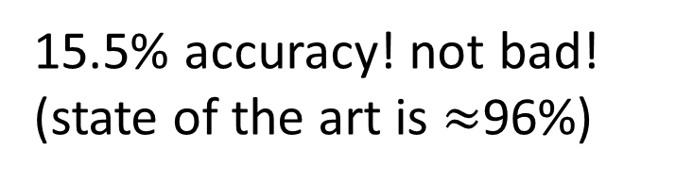
Lets see how well this works on the test set...
15.5% accuracy! not bad!
(state of the art is $≈$96%)

Slide 10
Strategy #2: Follow the slope

Slide 11
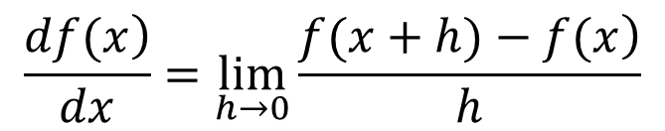
Strategy #2: Follow the slope
In 1-dimension, the derivative of a function:
$$\frac{\left.df(x\right)}{dx}=\lim_{h→0}\frac{\left.f(x+h)−f(x\right)}{h}$$
In multiple dimensions, the gradient is the vector of partial derivatives along
each dimension

Slide 12
current W:
gradient dL/dW:
[0.34,
-1.11,
0.78,
0.12,
0.55,
2.81,
-3.1,
-1.5,
0.33,…]
loss 1.25347
[?,
?,
?,
?,
?,
?,
?,
?,
?,…]

Slide 13
current W:
W + h (first dim):
gradient dL/dW:
[0.34,
-1.11,
0.78,
0.12,
0.55,
2.81,
-3.1,
-1.5,
0.33,…]
loss 1.25347
[0.34 + 0.0001,
-1.11,
0.78,
0.12,
0.55,
2.81,
-3.1,
-1.5,
0.33,…]
loss 1.25322
[?,
?,
?,
?,
?,
?,
?,
?,
?,…]

Slide 14
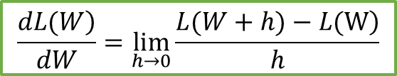
current W:
W + h (first dim):
gradient dL/dW:
[0.34,
-1.11,
0.78,
0.12,
0.55,
2.81,
-3.1,
-1.5,
0.33,…]
loss 1.25347
[0.34 + 0.0001,
-1.11,
0.78,
0.12,
0.55,
2.81,
-3.1,
-1.5,
0.33,…]
loss 1.25322
[-2.5,
?,
?,
?,
?,
?,
?,
?,
?,…]
(1.25322 - 1.25347)/0.0001
= -2.5
$$\frac{\left.dL(W\right)}{dW}=\lim_{h→0}\frac{\left.L(W+h)−L(W\right)}{h}$$

Slide 15
current W:
W + h (second dim):
gradient dL/dW:
[0.34,
-1.11,
0.78,
0.12,
0.55,
2.81,
-3.1,
-1.5,
0.33,…]
loss 1.25347
[0.34,
-1.11 + 0.0001,
0.78,
0.12,
0.55,
2.81,
-3.1,
-1.5,
0.33,…]
loss 1.25322
[-2.5,
?,
?,
?,
?,
?,
?,
?,
?,…]

Slide 16

current W:
W + h (second dim):
gradient dL/dW:
[0.34,
-1.11,
0.78,
0.12,
0.55,
2.81,
-3.1,
-1.5,
0.33,…]
loss 1.25347
[0.34,
-1.11 + 0.0001,
0.78,
0.12,
0.55,
2.81,
-3.1,
-1.5,
0.33,…]
loss 1.25353
[-2.5,
0.6,
?,
?,
?,
?,
?,
?,
?,…]
(1.25353 - 1.25347)/0.0001
= 0.6
$$\frac{\left.dL(W\right)}{dW}=\lim_{h→0}\frac{\left.L(W+h)−L(W\right)}{h}$$

Slide 17
current W:
W + h (third dim):
gradient dL/dW:
[0.34,
-1.11,
0.78,
0.12,
0.55,
2.81,
-3.1,
-1.5,
0.33,…]
loss 1.25347
[0.34,
-1.11,
0.78 + 0.0001,
0.12,
0.55,
2.81,
-3.1,
-1.5,
0.33,…]
loss 1.25347
[-2.5,
0.6,
?,
?,
?,
?,
?,
?,
?,…]

Slide 18

current W:
W + h (third dim):
gradient dL/dW:
[0.34,
-1.11,
0.78,
0.12,
0.55,
2.81,
-3.1,
-1.5,
0.33,…]
loss 1.25347
[0.34,
-1.11,
0.78 + 0.0001,
0.12,
0.55,
2.81,
-3.1,
-1.5,
0.33,…]
loss 1.25347
[-2.5,
0.6,
0,
?,
?,
?,
?,
?,
?,…]
(1.25347 - 1.25347)/0.0001
= 0
$$\frac{\left.dL(W\right)}{dW}=\lim_{h→0}\frac{\left.L(W+h)−L(W\right)}{h}$$

Slide 19
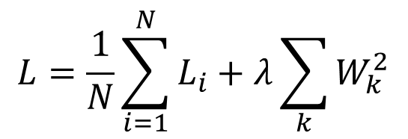
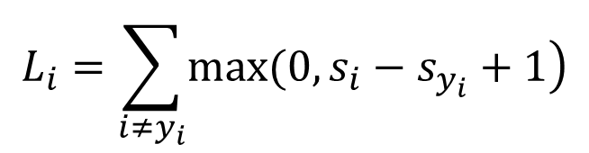
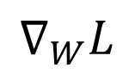
Can we do better?
The loss is just a function of W:
$$L=\frac{1}{N}\sum_{i=1}^{N}{L_{i}}+λ\sum_{k}{W_{k}^{2}}$$
$$L_{i}=\sum_{i≠y_{i}}{\left.max(0,s_{i}−s_{y_{i}}+1\right)}$$
s=f(x,W) = Wx + b
want
$$∇_{W}L$$

Slide 20
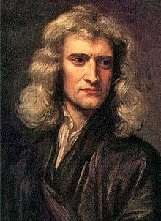
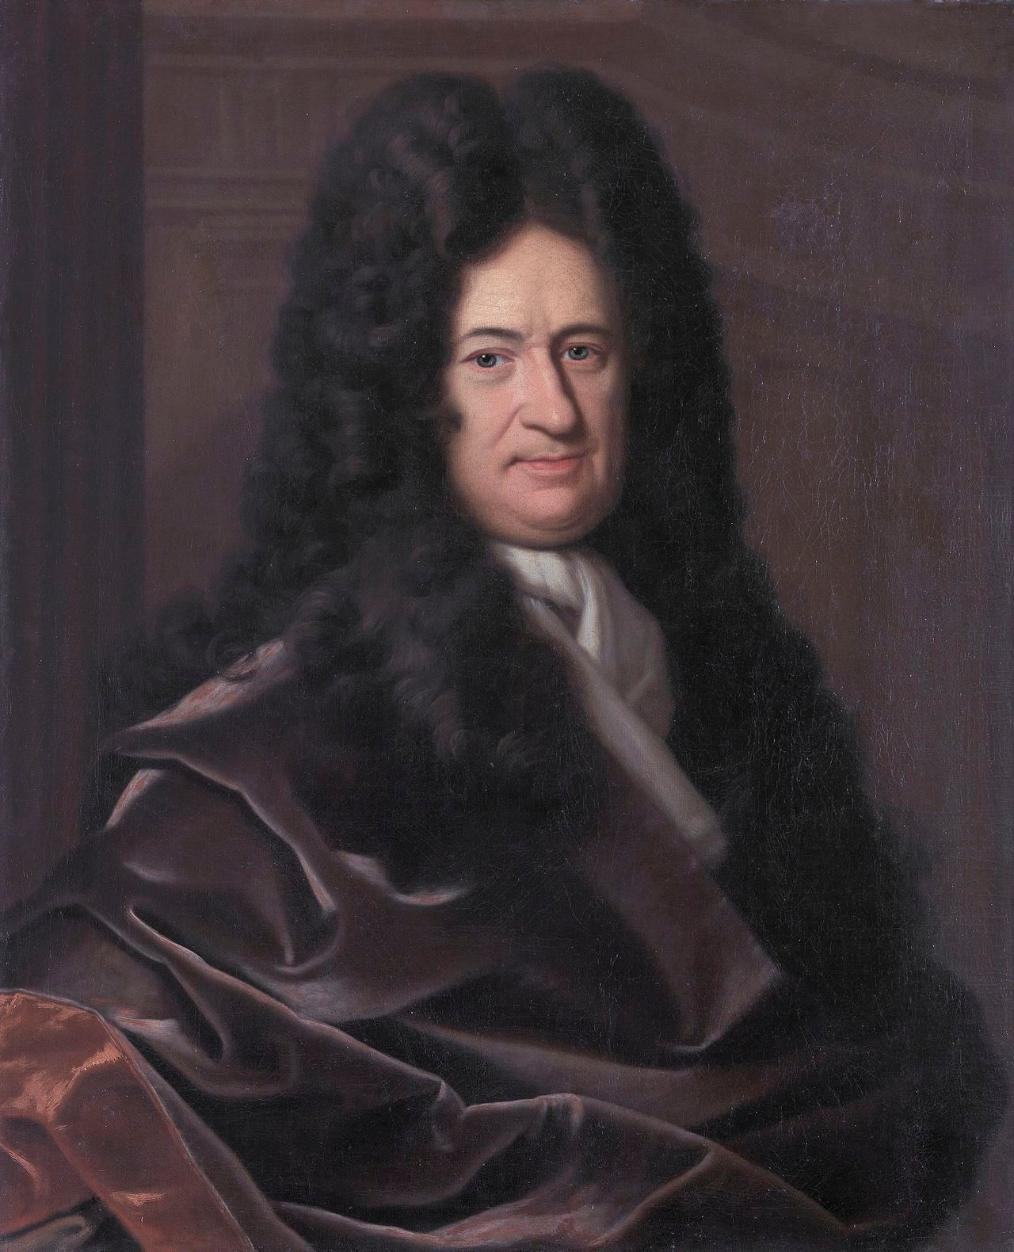
Can we do better?
The loss is just a function of W:
$$L=\frac{1}{N}\sum_{i=1}^{N}{L_{i}}+λ\sum_{k}{W_{k}^{2}}$$
$$L_{i}=\sum_{i≠y_{i}}{\left.max(0,s_{i}−s_{y_{i}}+1\right)}$$
s=f(x,W) = Wx + b
want
$$∇_{W}L$$

Slide 21

Can we do better?
The loss is just a function of W:
$$L=\frac{1}{N}\sum_{i=1}^{N}{L_{i}}+λ\sum_{k}{W_{k}^{2}}$$
$$L_{i}=\sum_{i≠y_{i}}{\left.max(0,s_{i}−s_{y_{i}}+1\right)}$$
s=f(x,W) = Wx + b
Calculus!
want
$$∇_{W}L$$

Slide 22
current W:
gradient dL/dW:
[0.34,
-1.11,
0.78,
0.12,
0.55,
2.81,
-3.1,
-1.5,
0.33,…]
loss 1.25347
[-2.5,
0.6,
0,
0.2,
0.7,
-0.5,
1.1,
1.3,
-2.1,…]
dL/dW = ...
(some function
data and W)

Slide 23
Recap
Numerical gradient: approximate, slow, easy to write
Analytic gradient: exact, fast, error-prone
In practice: Always use analytic gradient, but check implementation with numerical gradient. This is called a gradient check.

Slide 24
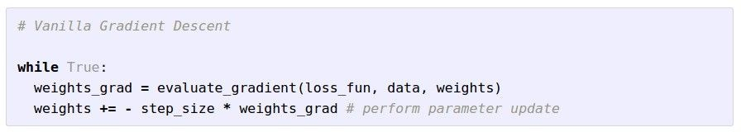
Gradient Descent

Slide 25
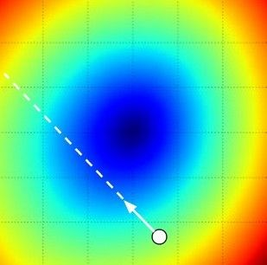
W₂
original W
W₁
negative gradient direction

Slide 26
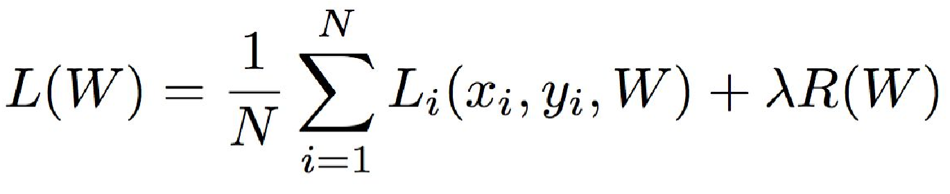
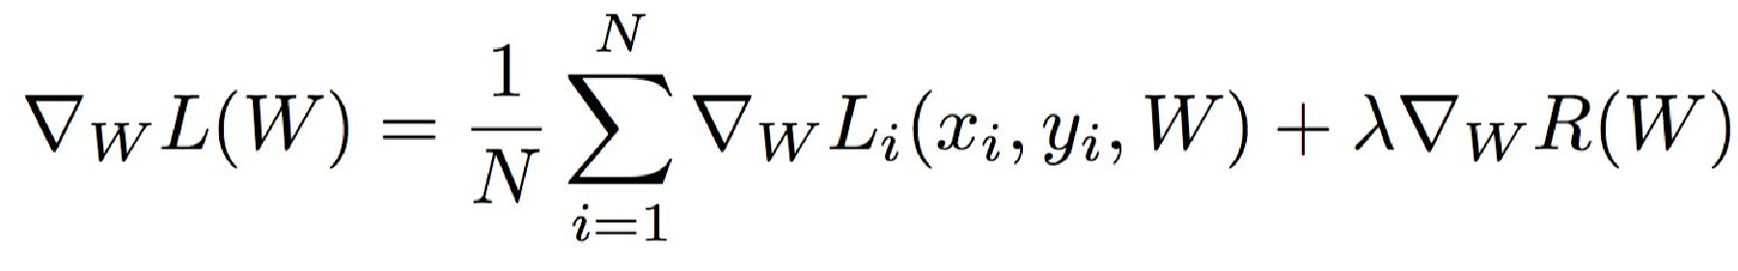
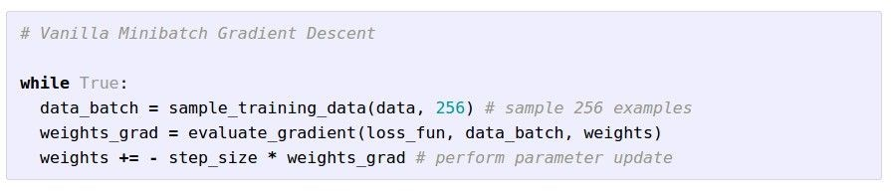
Stochastic Gradient Descent (SGD)
Full sum expensive when
N is large!
Approximate sum using a minibatch of examples
32 / 64 / 128 common

Slide 27
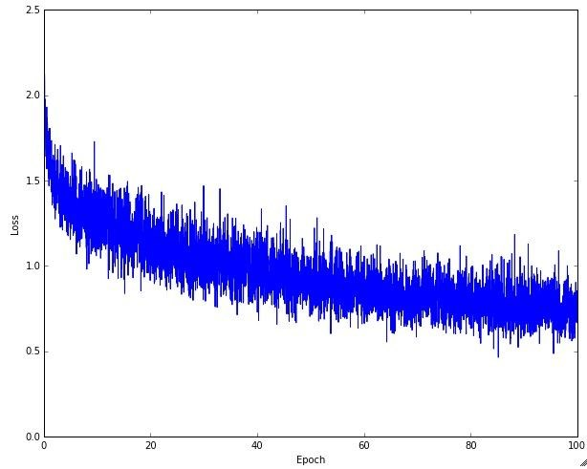
Example of optimization progress while training a neural network.
(Loss over mini-batches goes down over time.)

Slide 28
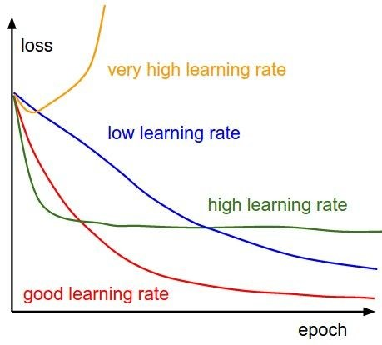
The effects of step size (or “learning rate”)

Slide 29
Stochastic Gradient Descent (SGD)
Full sum expensive when
N is large!
Approximate sum using a minibatch of examples
32 / 64 / 128 common
we will look at more
fancy update formulas
(momentum, Adagrad,
RMSProp, Adam, …)

Slide 30
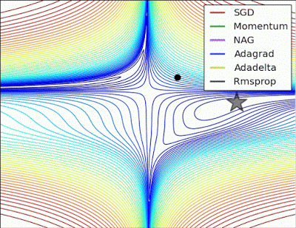
The effects of
different
update form
formulas

Slide 31
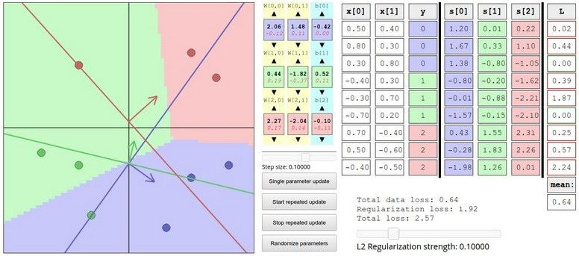
Interactive Web Demo time....
http://vision.stanford.edu/teaching/cs231n-demos/linear-classify/

Slide 32
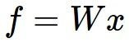
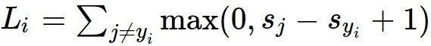
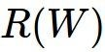
Computational graphs
x
s
(scores)
hinge loss
+
*
L
W
R

Slide 33
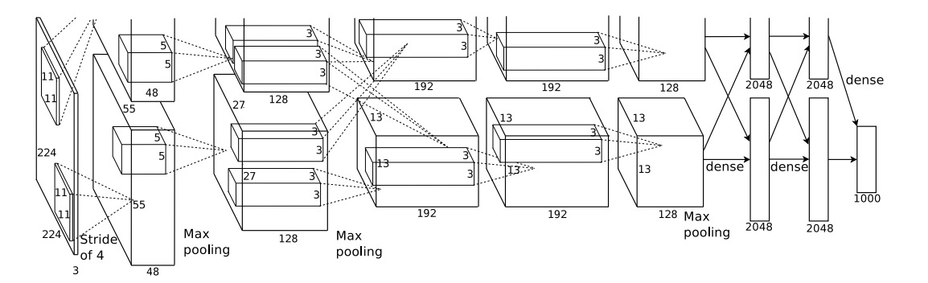
Convolutional Network
AlexNet
weights
input image
loss

Slide 34
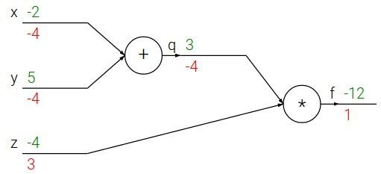
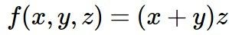
Backpropagation: a simple example
e.g. x = -2, y = 5, z = -4

Slide 35
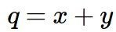
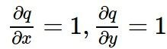
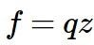
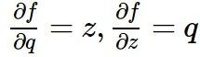
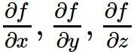
Backpropagation: a simple example
e.g. x = -2, y = 5, z = -4
Want:

Slide 36
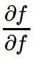
Backpropagation: a simple example
e.g. x = -2, y = 5, z = -4
Want:

Slide 37
Backpropagation: a simple example
e.g. x = -2, y = 5, z = -4
1
Want:

Slide 38

Backpropagation: a simple example
e.g. x = -2, y = 5, z = -4
1
Want:

Slide 39
Backpropagation: a simple example
e.g. x = -2, y = 5, z = -4
1
3
Want:

Slide 40

Backpropagation: a simple example
e.g. x = -2, y = 5, z = -4
1
3
Want:

Slide 41
Backpropagation: a simple example
-4
e.g. x = -2, y = 5, z = -4
1
3
Want:

Slide 42

Backpropagation: a simple example
-4
e.g. x = -2, y = 5, z = -4
1
3
Want:

Slide 43



Backpropagation: a simple example
-4
e.g. x = -2, y = 5, z = -4
-4
1
3
Chain rule:
Want:

Slide 44

Backpropagation: a simple example
-4
e.g. x = -2, y = 5, z = -4
-4
1
3
Want:

Slide 45
Backpropagation: a simple example
-4
-4
e.g. x = -2, y = 5, z = -4
-4
1
3
Chain rule:
Want:

Slide 46


f

Slide 47


“local gradient”
f

Slide 48

“local gradient”
f
gradients

Slide 49

“local gradient”
f
gradients

Slide 50

“local gradient”
f
gradients

Slide 51
“local gradient”
f
gradients

Slide 52


Another example:

Slide 53


Another example:

Slide 54
Another example:

Slide 55

Another example:

Slide 56
Another example:

Slide 57

Another example:

Slide 58
Another example:

Slide 59

Another example:

Slide 60
Another example:

Slide 61
Another example:
(-1)*0.20=0.20

Slide 62
Another example:

Slide 63
Another example:
[local gradient] x [upstream gradient]
[1] x [0.2] = 0.2
[1] x [0.2] = 0.2 (both inputs!)

Slide 64
Another example:

Slide 65
Another example:
[local gradient] x [upstream gradient]
x0: [2] x [0.2] = 0.4
w0: [-1] x [0.2] = -0.2

Slide 66


sigmoid function
sigmoid gate

Slide 67
sigmoid function
sigmoid gate
(0.73) * (1 - 0.73) = 0.2

Slide 68

Patterns in backward flow
add gate: gradient distributor

Slide 69
Patterns in backward flow
add gate: gradient distributor
Q: What is a max gate?

Slide 70
Patterns in backward flow
add gate: gradient distributor
max gate: gradient router

Slide 71
Patterns in backward flow
add gate: gradient distributor
max gate: gradient router
Q: What is a mul gate?

Slide 72
Patterns in backward flow
add gate: gradient distributor
max gate: gradient router
mul gate: gradient switcher

Slide 73
Gradients in branches (shared variables)
y=3
6
2
*
x=2
+
Sum of gradients
10
2
*
z=5

Slide 74
Gradients for vectorized code
(
x,y,z are
This is now the
now vectors)
Jacobian matrix
(
derivative of each
element of z w.r.t. each
“local gradient”
element of x)
f
gradients

Slide 75
Vectorized operations
4096-
4096-d
f(x) = max(0,x)
d
output vector
(
elementwise
output vector
)

Slide 76

Vectorized operations
Jacobian matrix
4096-
4096-d
f(x) = max(0,x)
d
output vector
(
elementwise
output vector
)
Q: what is the
size of the
Jacobian matrix?

Slide 77
Vectorized operations
Jacobian matrix
4096-
4096-d
f(x) = max(0,x)
d
output vector
(
elementwise
output vector
)
Q: what is the
size of the
Jacobian matrix?
[4096 x 4096!]

Slide 78
Vectorized operations
4096-
4096-d
f(x) = max(0,x)
d
output vector
(
elementwise
output vector
)
in practice we process an
entire minibatch (e.g. 100)
of examples at one time:
i.e. Jacobian would technically be a
[409,600 x 409,600] matrix
Q: what is the
size of the
Jacobian matrix?
[4096 x 4096!]

Slide 79
Vectorized operations
Jacobian matrix
4096-
4096-d
f(x) = max(0,x)
d
output vector
(
elementwise
output vector
)
Q: what is the
size of the
Jacobian matrix?
[4096 x 4096!]
Q2: what does it
look like?

Slide 80
A vectorized example:

Slide 81

A vectorized example:

Slide 82



A vectorized example:
q

Slide 83

A vectorized example:
q

Slide 84
A vectorized example:
q

Slide 85


A vectorized example:
q

Slide 86

A vectorized example:
q

Slide 87

A vectorized example:
q

Slide 88



A vectorized example:
q

Slide 89

A vectorized example:
q

Slide 90

A vectorized example:
q

Slide 91
A vectorized example:
q
Always check: The
gradient with
respect to a variable
should have the
same shape as the
variable

Slide 92

A vectorized example:
q

Slide 93


A vectorized example:
q

Slide 94


A vectorized example:
q

Slide 95


Modularized implementation: forward / backward API
Graph (or Net) object (rough psuedo code)

Slide 96



Modularized implementation: forward / backward API
x
z
*
y
(x,y,z are scalars)

Slide 97

Modularized implementation: forward / backward API
x
z
*
y
(x,y,z are scalars)

Slide 98




Example: Caffe layers
=

Slide 99


Caffe Sigmoid Layer
forward()
backward()
* top_diff (chain rule)

Slide 100
Backpropagation summary
neural nets will be very large: impractical to write down gradient formula by hand for all parameters
backpropagation = recursive application of the chain rule along a computational graph to compute the gradients of all inputs/parameters/intermediates
implementations maintain a graph structure, where the nodes implement the forward() / backward() API
forward: compute result of an operation and save any intermediates needed for gradient computation in memory
backward: apply the chain rule to compute the gradient of the loss function with respect to the inputs

Slide 101

Neural Networks

Slide 102

Neural networks: without the brain stuff
(Before) Linear score function:

Slide 103

Neural networks: without the brain stuff
(Before) Linear score function:
(Now) 2-layer Neural Network:

Slide 104
Neural networks: without the brain stuff
(Before) Linear score function:
(Now) 2-layer Neural Network:
x
W1
h
W2
s
100
10
hidden layer

Slide 105
Neural networks: without the brain stuff
(Before) Linear score function:
(Now) 2-layer Neural Network:
x
W1
h
W2
s
100
10

Slide 106
Neural networks: without the brain stuff
(Before) Linear score function:
(Now) 2-layer Neural Network:
or we can go deeper
3-layer Neural Network

Slide 107

Full implementation of training a 2-layer Neural Network needs ~20 lines:

Slide 108

Biological neuron and artificial neuron

Slide 109


Slide 110


Slide 111


sigmoid activation function

Slide 112


Slide 113
Be very careful with your brain analogies!
Biological Neurons:
Many different types
Dendrites can perform complex non-linear computations
Synapses are not a single weight but a complex non-linear dynamical system
Rate code may not be adequate

Slide 114











Activation functions
Sigmoid
Leaky ReLU
tanh
Maxout
ReLU
ELU

Slide 115


Neural networks: Architectures
“2-layer Neural Net”, or
“1-hidden-layer Neural Net”
“3-layer Neural Net”, or
“2-hidden-layer Neural Net”
“Fully-connected” layers

Slide 116

Example feed-forward computation of a neural network

Slide 117


Demo time
Setting the number of layers and their sizes
Setting regularization
http://cs.stanford.edu/people/karpathy/convnetjs/demo/classify2d.html

Slide 118
Summary
we arrange neurons into fully-connected layers
The abstraction of a layer has the nice property that it allows us to use efficient vectorized code (e.g. matrix multiplies)
Neural networks are not really neural
Next time: Convolutional Neural Networks

